Slide 1
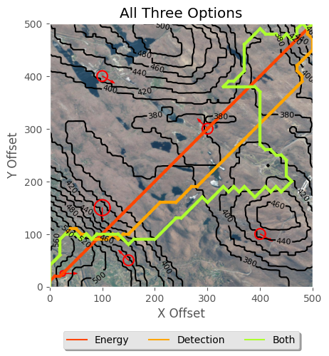
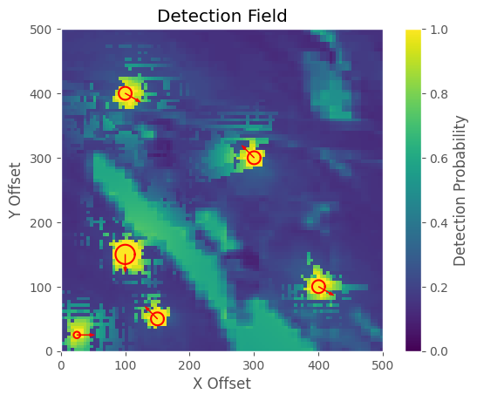
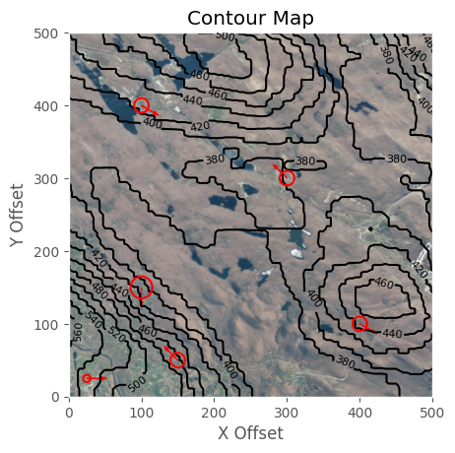

Improvements to Optimized Tactical Route Planning
PRESENTER: CDT Jacob Hyatt
Optimal path for an unmanned ground vehicle in a contested environment
[ROUGH DRAFT]
Toy Example
Introduction
Formulas
II. Methods
Pull from the 6 week update brief
Optimization Function
III. Results
Discuss results
Detection Fields
Vegetation Density
Contour Map
CDT Jacob Hyatt
LTC James Grymes

Slide 2
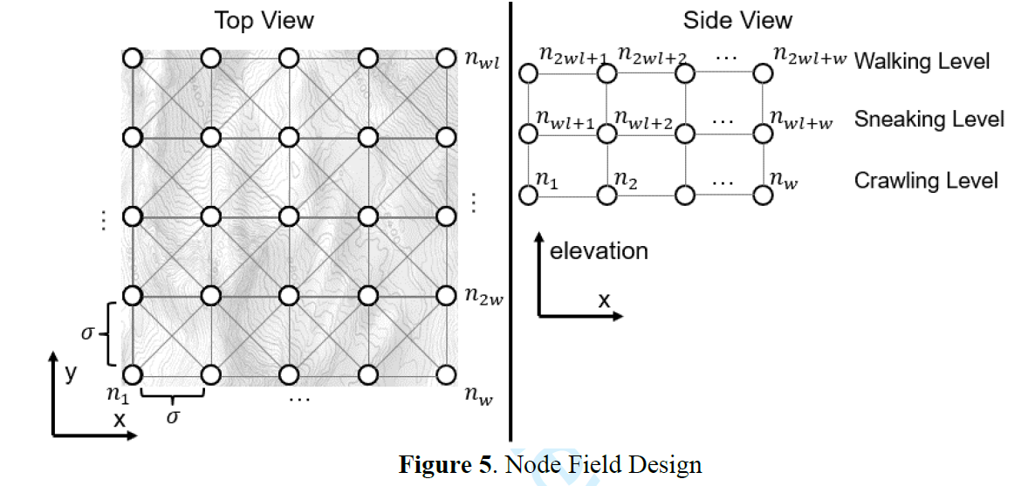
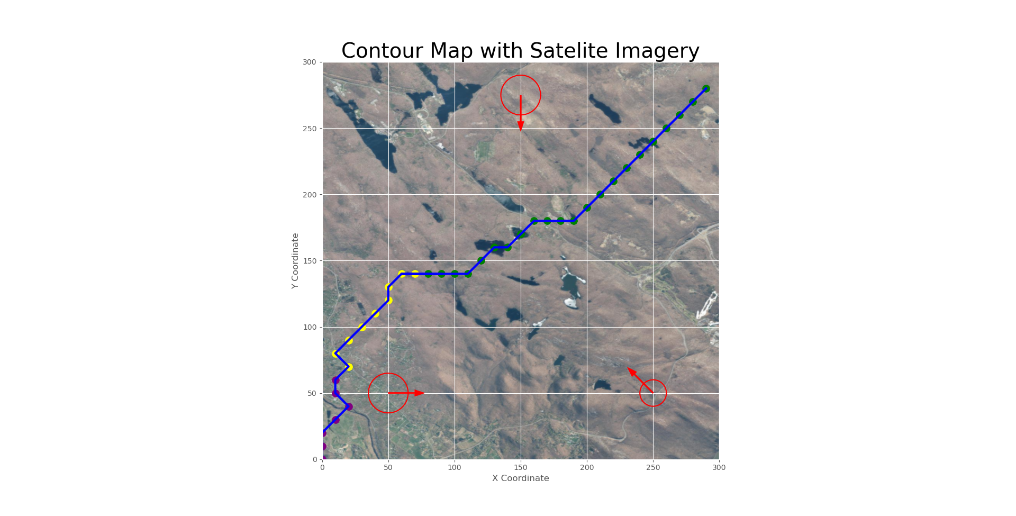
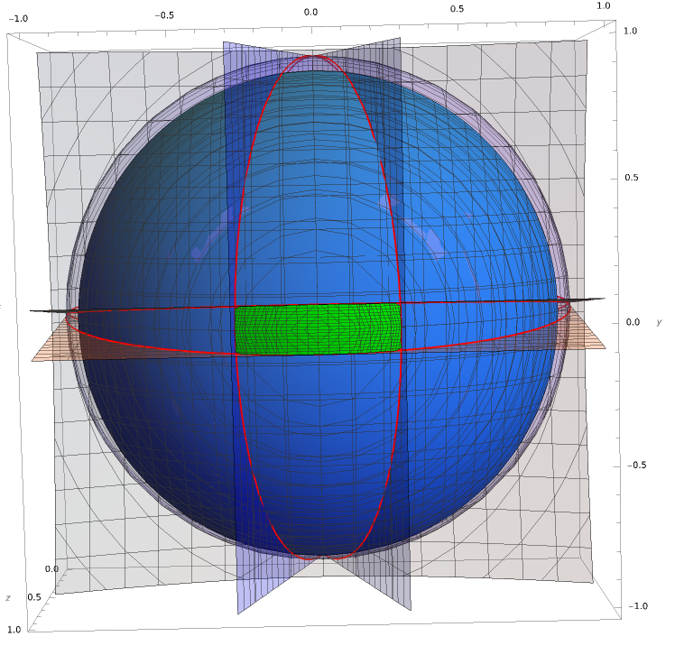
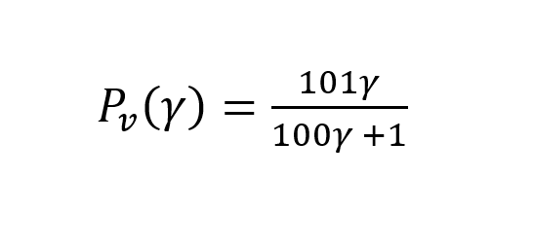
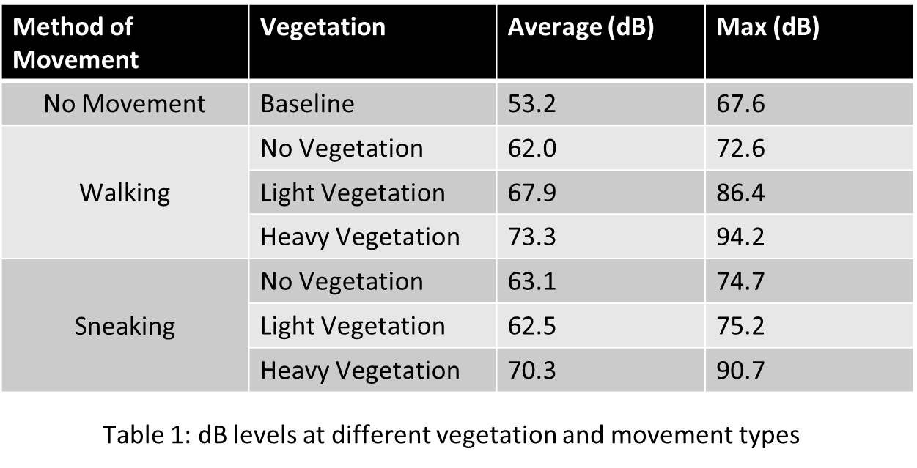
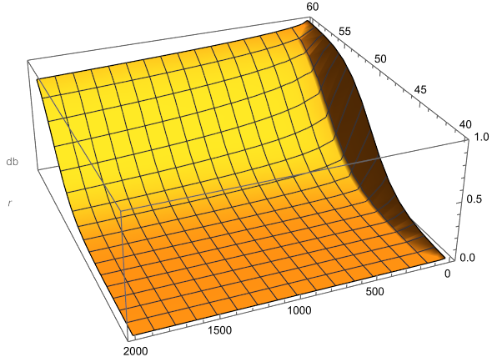
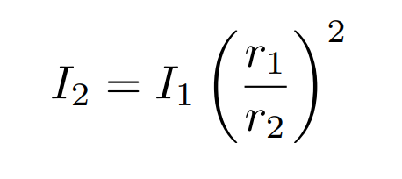
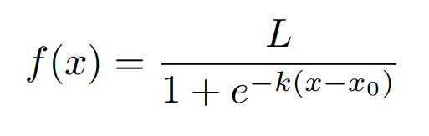
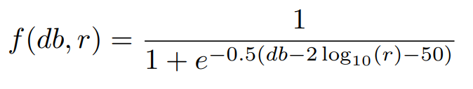
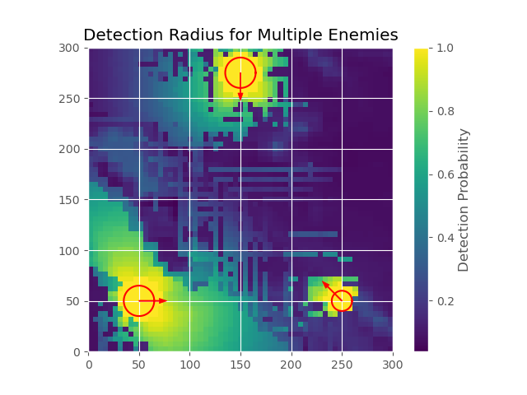
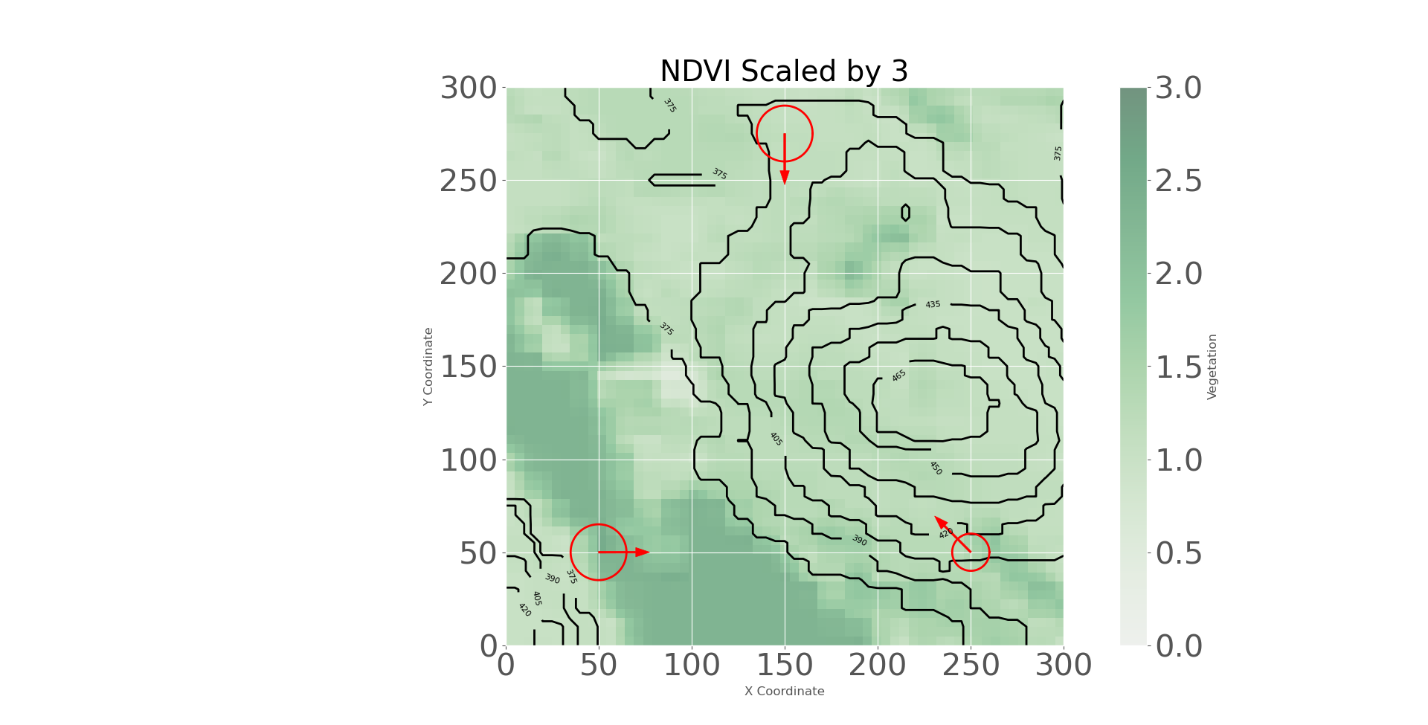
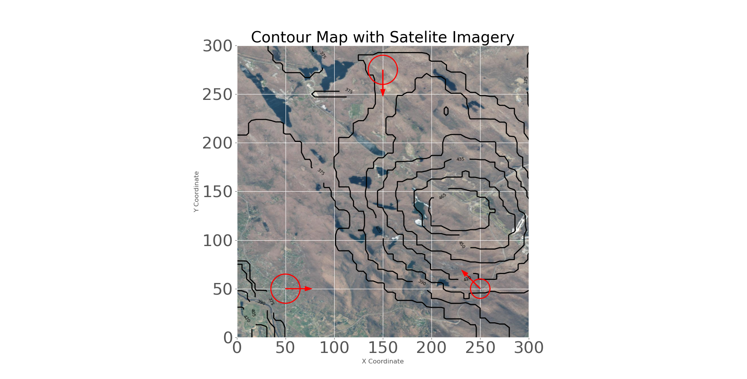


Improvements to Optimized Tactical Route Planning
PRESENTER: CDT Jacob Hyatt
Finding the safest and fastest path for a soldier in the presence of multiple enemies.
Introduction
Maximize mission success and soldier survivability by ensuring soldiers get to their destinations with the least chance of detection.
Enable decision makers to spend less time on route planning by giving a viable path to begin planning from.
Creation of a framework for optimized tactical route planning on different platforms.
$$γ=\frac{evader′s trace}{seeker^{′}s visual field}=\frac{2π−4\left(\arcsin\left[\frac{\cos{\frac{α}{2}}\tan{\frac{β}{2}}}{\sqrt{\tan^{2}{\frac{α}{2}}+\tan^{2}{\frac{β}{2}}}}\right]+\arcsin\left[\frac{\cos{\frac{β}{2}}\tan{\frac{α}{2}}}{\sqrt{\tan^{2}{\frac{α}{2}}+\tan^{2}{\frac{β}{2}}}}\right]\right)}{3.7505}$$
II. Methods
Utilized Geospatial imagery to compile vegetation density and elevation into a single source
Lay three-dimensional nodal network over imagery to account for different methods of movement
Define start, end node, and suspected seeker location with uncertainty
Utilize custom visual and audio equations to calculate the probability of detection for each node
Utilize Gurobi Optimizer to optimize a path based on probability of detection and speed.
dB Decay
dB
Potential Seeker Locations
p
Walking
III. Results
Sneaking
r
Crawling
Creates an optimal path for a soldier to take given the location of multiple enemies, elevation, and vegetation while minimizing the chance of detection
Take a picture to download full paper
Detection Fields
Vegetation Density
Contour Map
CDT Jacob Hyatt
MAJ Thomas Kendall

